Slide 1
Git & GitHub
- By Tejal Pathak

Slide 2
Topics to study:
Version control system
Installation of Git
Introduction to Git
Git Basics
Branching
Merging
Rebasing
Reflog
Stashing
GitHub
Extra Tools

Slide 3
VCS: What is VCS ?
VCS stands for version control system.
Version control is the practice of managing and tracking changes in software codes. It is also known as source control.
Version control system is simply a software which helps us managing a version control.
It allows to maintain code efficiently.

Slide 4
Types of VCS
Local VCS
Centralized VCS
Distributed VCS

Slide 5
Local VCS
All changes done in the file will be stored locally and will be only available on user’s machine.
Changes are stored with time so as to keep the track of when exactly changes were made.

Slide 6
Disadvantages of Local VCS
Since all the changes are stored locally, If the hard disk gets corrupted then the project can be lost.
No other person can access your changes.

Slide 7
Centralized VCS
In Centralized VCS there is only one central repository where all changes are made by multiple people.
Multiple people can get the code from central repo and then push their changes into same repo.

Slide 8
Disadvantages of Centralized VCS
In case central repo is not available or down for some time no one will be able to get the code from the repo and push the changes.
If the hard disk where central repo is changed get’s corrupted then the entire history of the project will get lost.

Slide 9
Distributed VCS
In Distributed VCS user has their own copy of repository from central repository.
Even if central repo goes down user still has their own copy of repo and they can continue working with that.

Slide 10
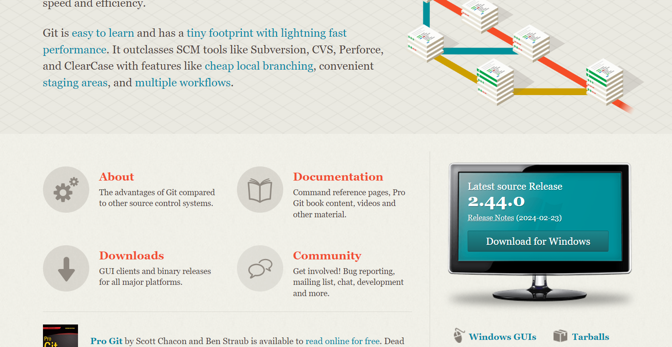

Installation of Git on Windows
Go to this URL - https://git-scm.com/

Slide 11
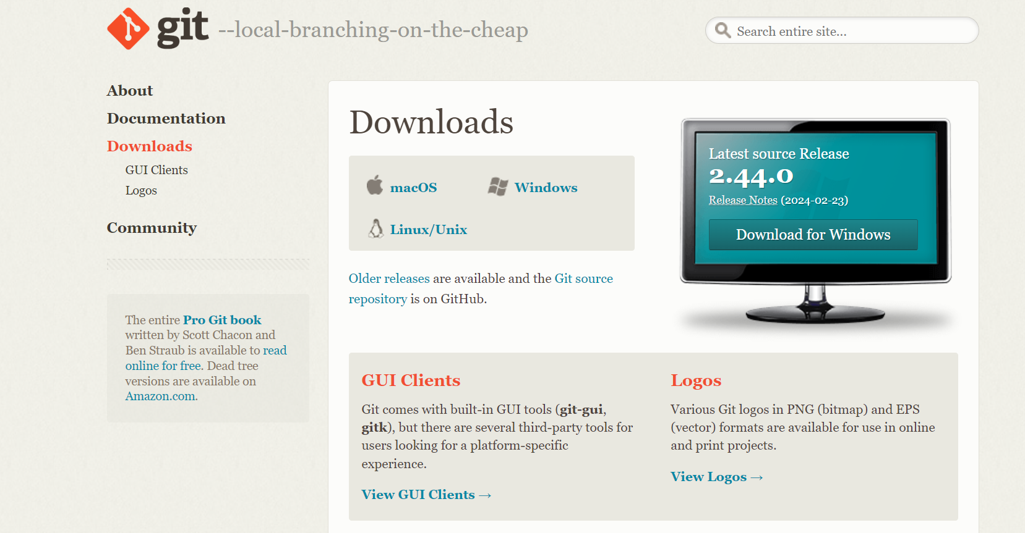


Slide 12
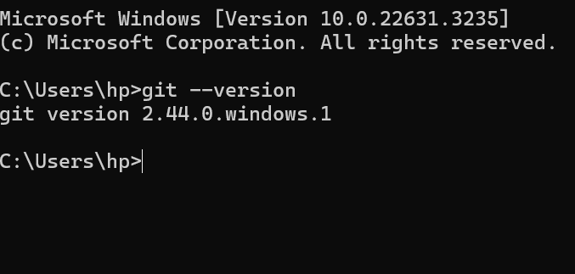
Your git is installed – to check if it’s installed open command prompt and check: git --version

Slide 13
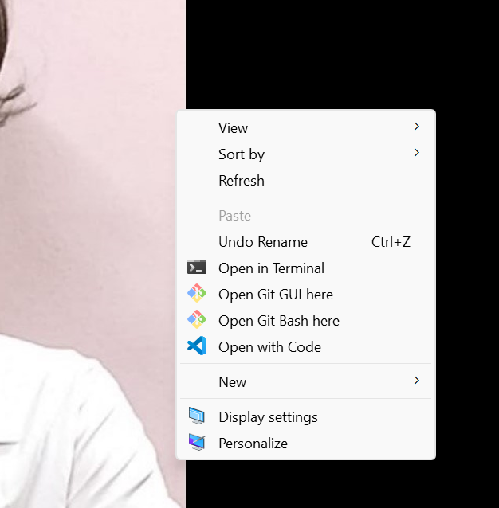

To configure Git
Go to desktop and right click -> git bash

Slide 14
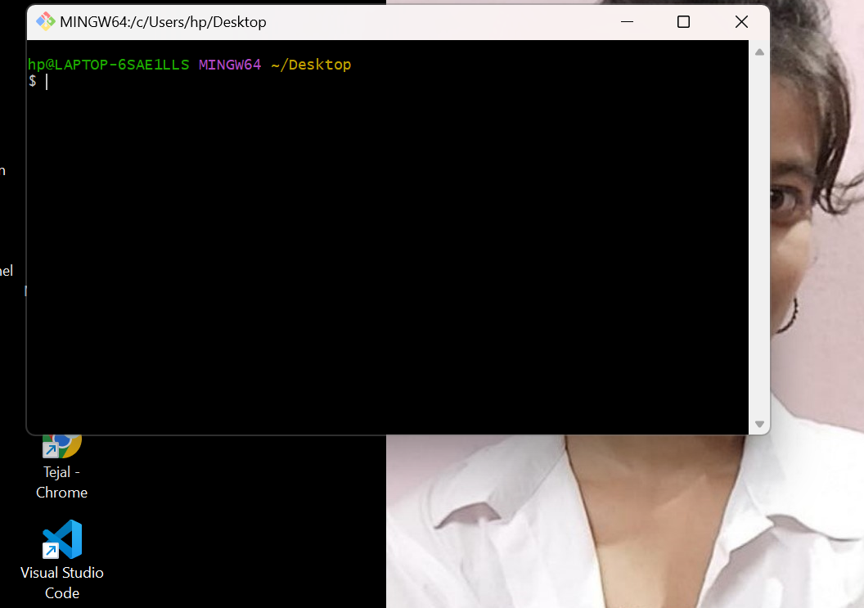

Slide 15
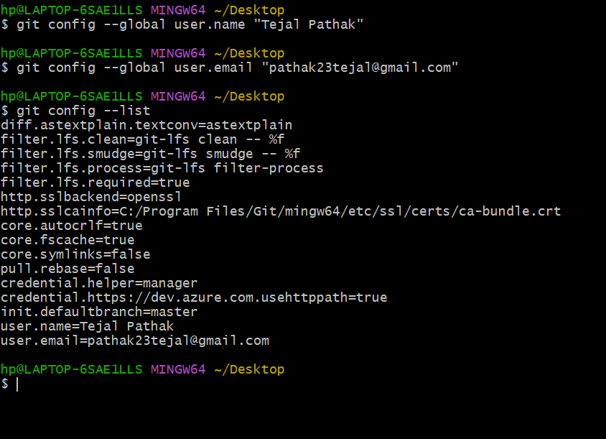

Slide 16
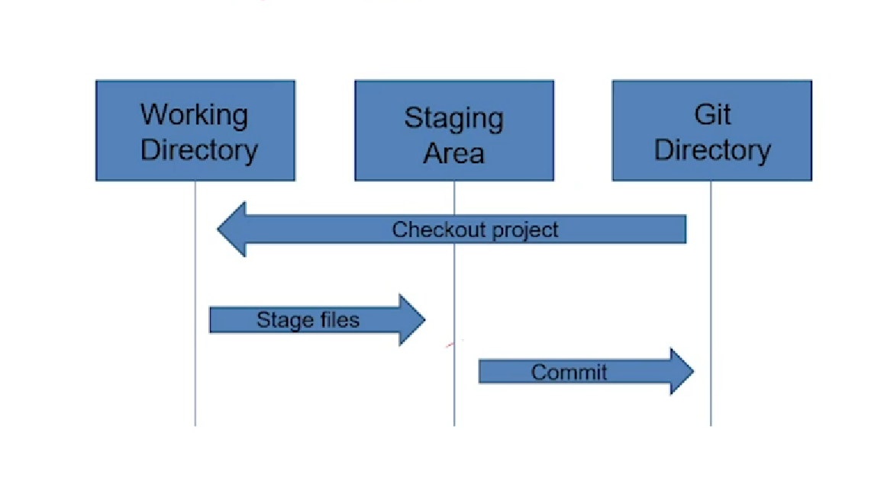
Introduction to Git – Three stage architecture

Slide 17
How Git differs from other VCS?
Git – Distributed VCS
Git – Open source
Git – Command Line / GUI
Cloud Hosting
GitHub

Slide 18
Git Basics – Initializing a Git repository
Command – git init
This is usually the very first command you will ever run when starting with a new project.
Without this command no git command would ever work.
The git init command creates a new Git repository for you.
1] Convert and existing, unversioned project to git repository.
2]Initialise a new empty git repository.

Slide 19
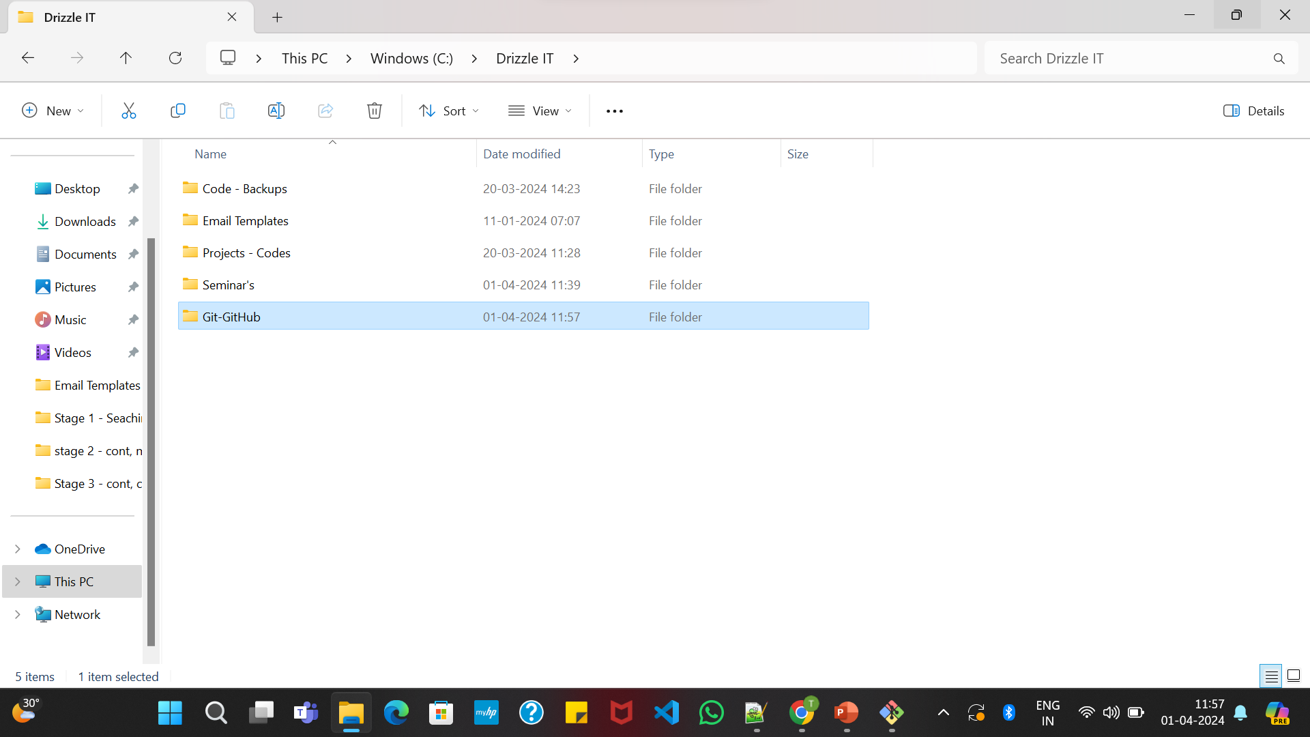

Executing git init creates a .git subdirectory in the current working directory, which contains all the necessary git metadata from new repository.
For this create a new folder :

Slide 20
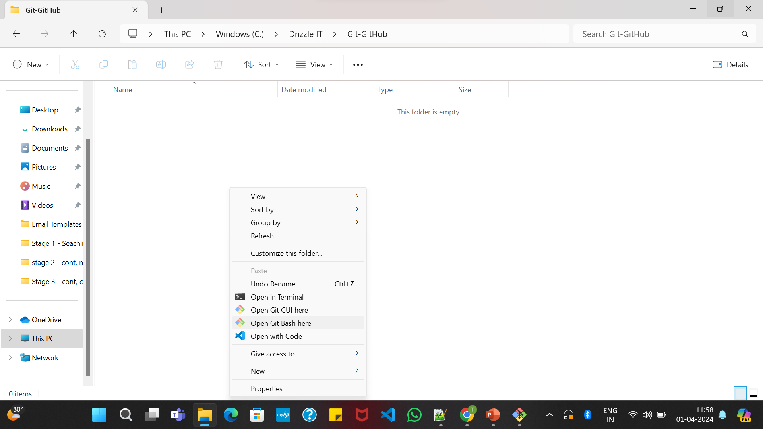
Open gitbash in the current directory.

Slide 21
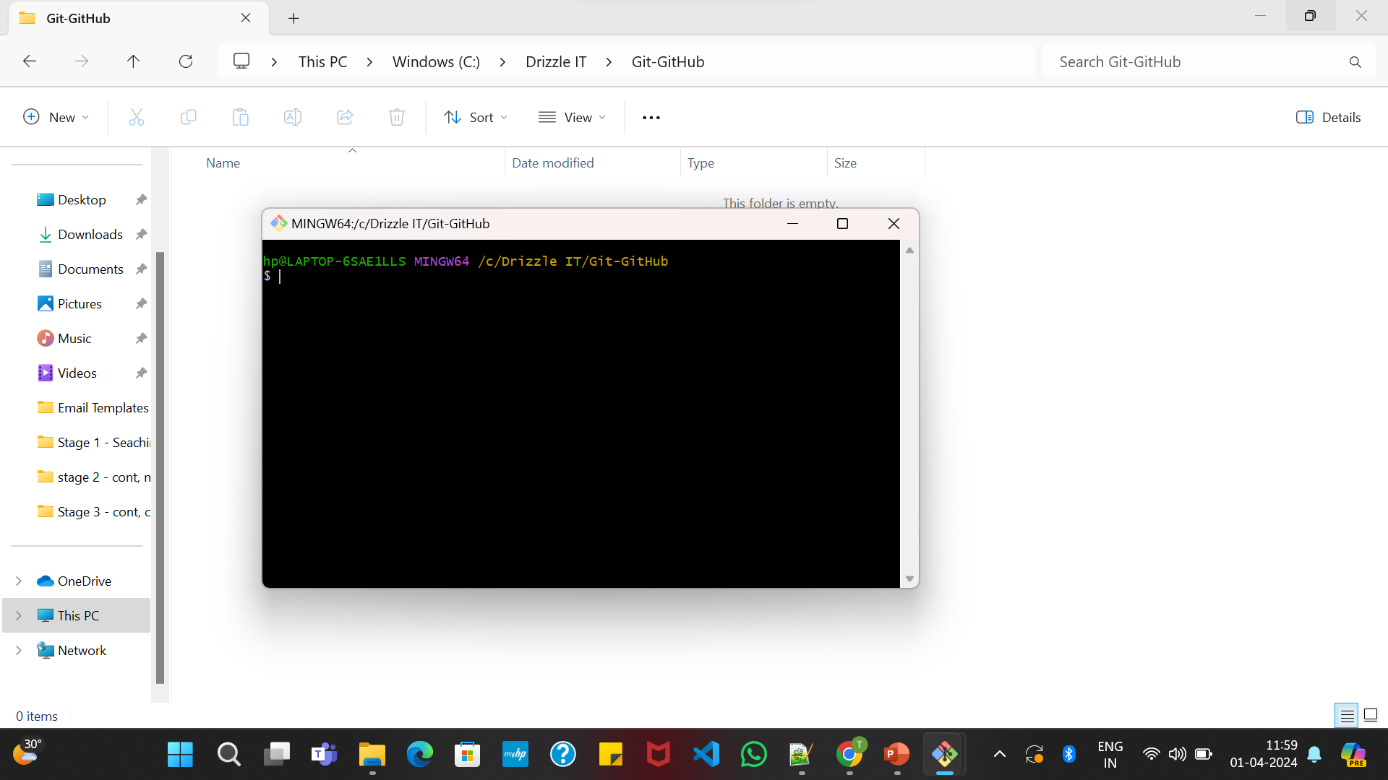

Slide 22
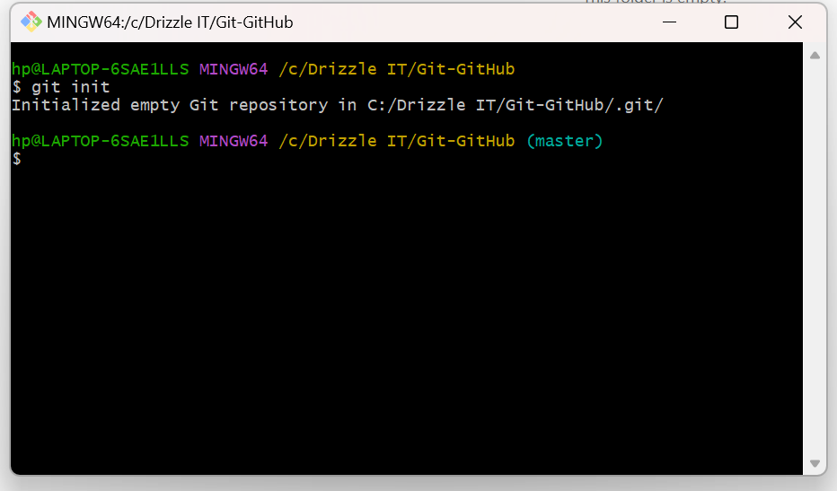
New empty repo is been initialized.

Slide 23
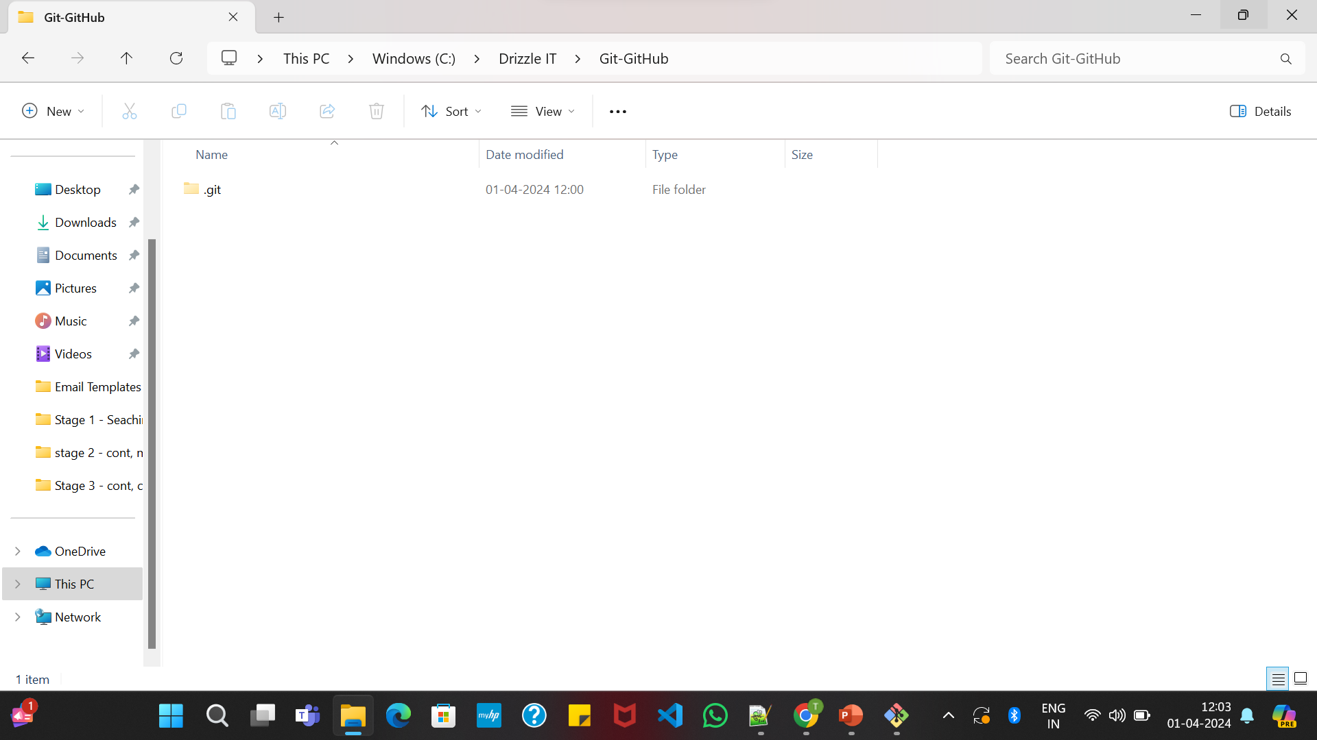

View –> Untick show hidden –> Now we will be able to see the file

Slide 24
Adding files and committing to the repository
Git Add – Adds file folder to staging area.
Command – git add filename
Git Add –All files:
1] git add –all
2] git add –A
3] git add .

Slide 25
Git Commit – Adds staged changes to local repository
Command:
git commit
git commit –m “message”

Slide 26
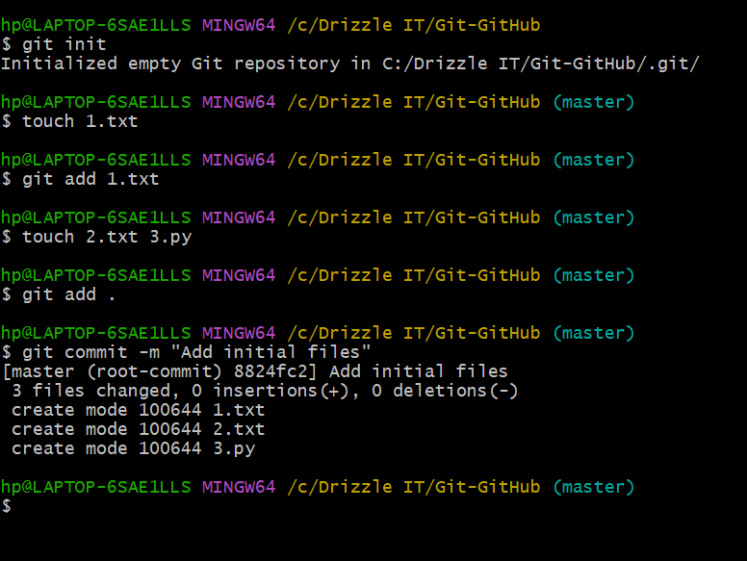

Slide 27
Repository – History & Status
Status – Status of your staged areas. (git status)
History – History of commits. (git log)
Open working directory -> open Git bash -> git init -> add files -> status -> commit

Slide 28
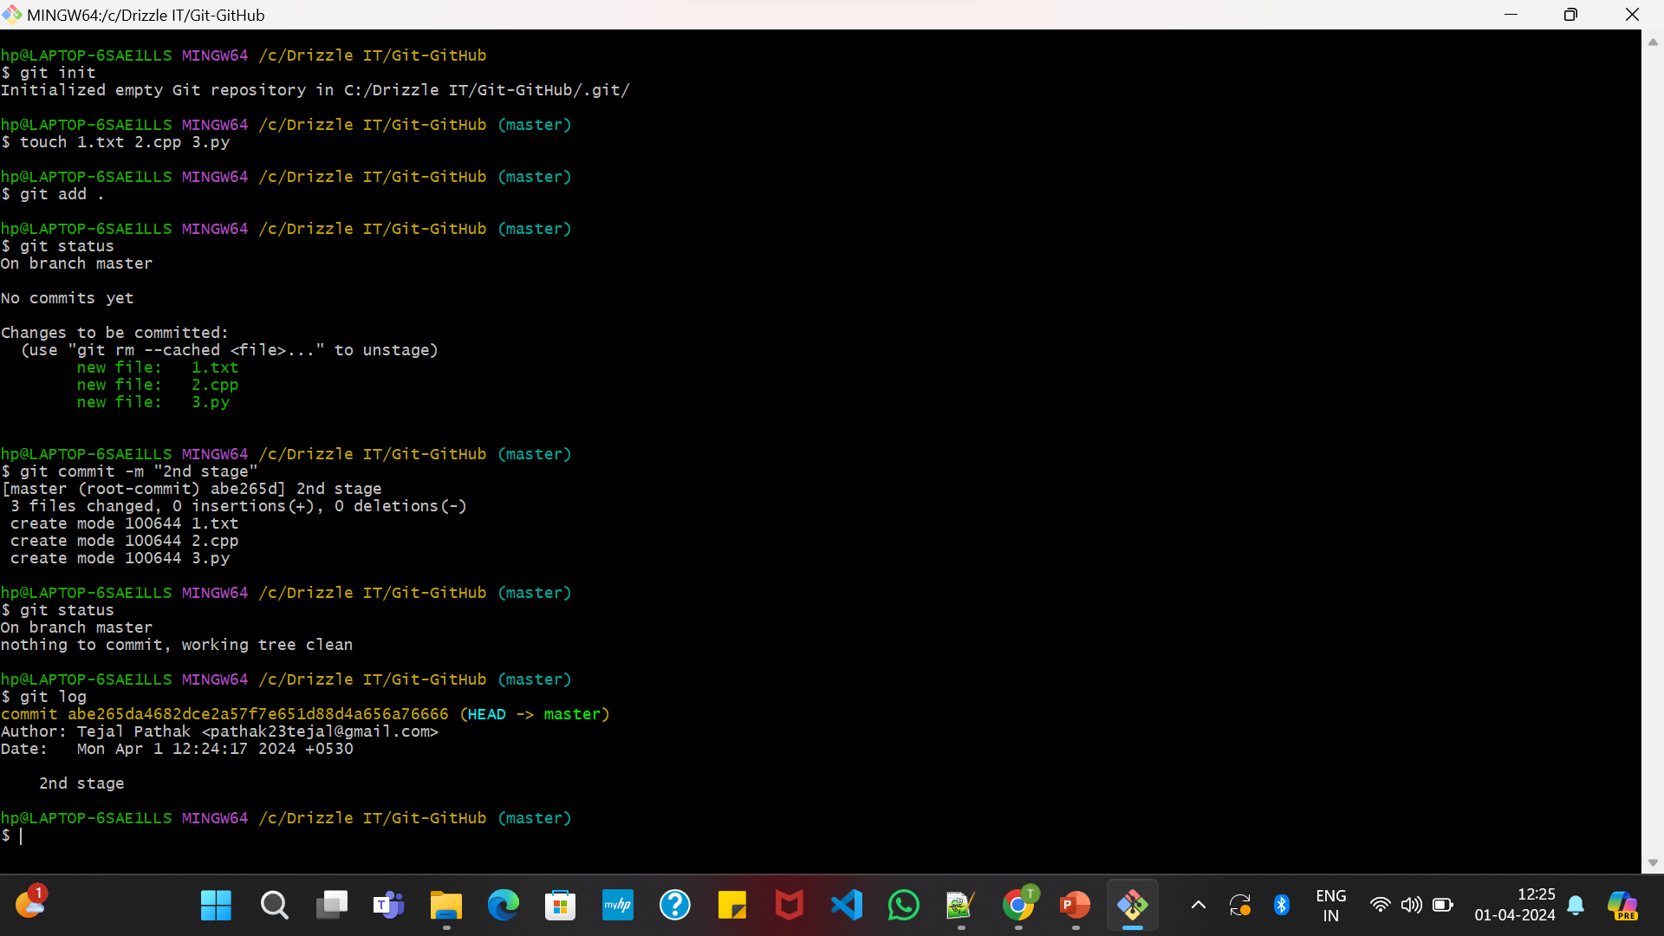

Slide 29
Branching – What is branching and why do we need branching ?
Default branch of Git is Master Branch.
How dose Branching help ?
Try a new feature
Collaboration

Slide 30
Creating and switching between branches
Create branch : git branch <branch name>
Switching branch : git checkout <branch name>
Note – we cannot create a new branch unless the stage is all cleared.

Slide 31
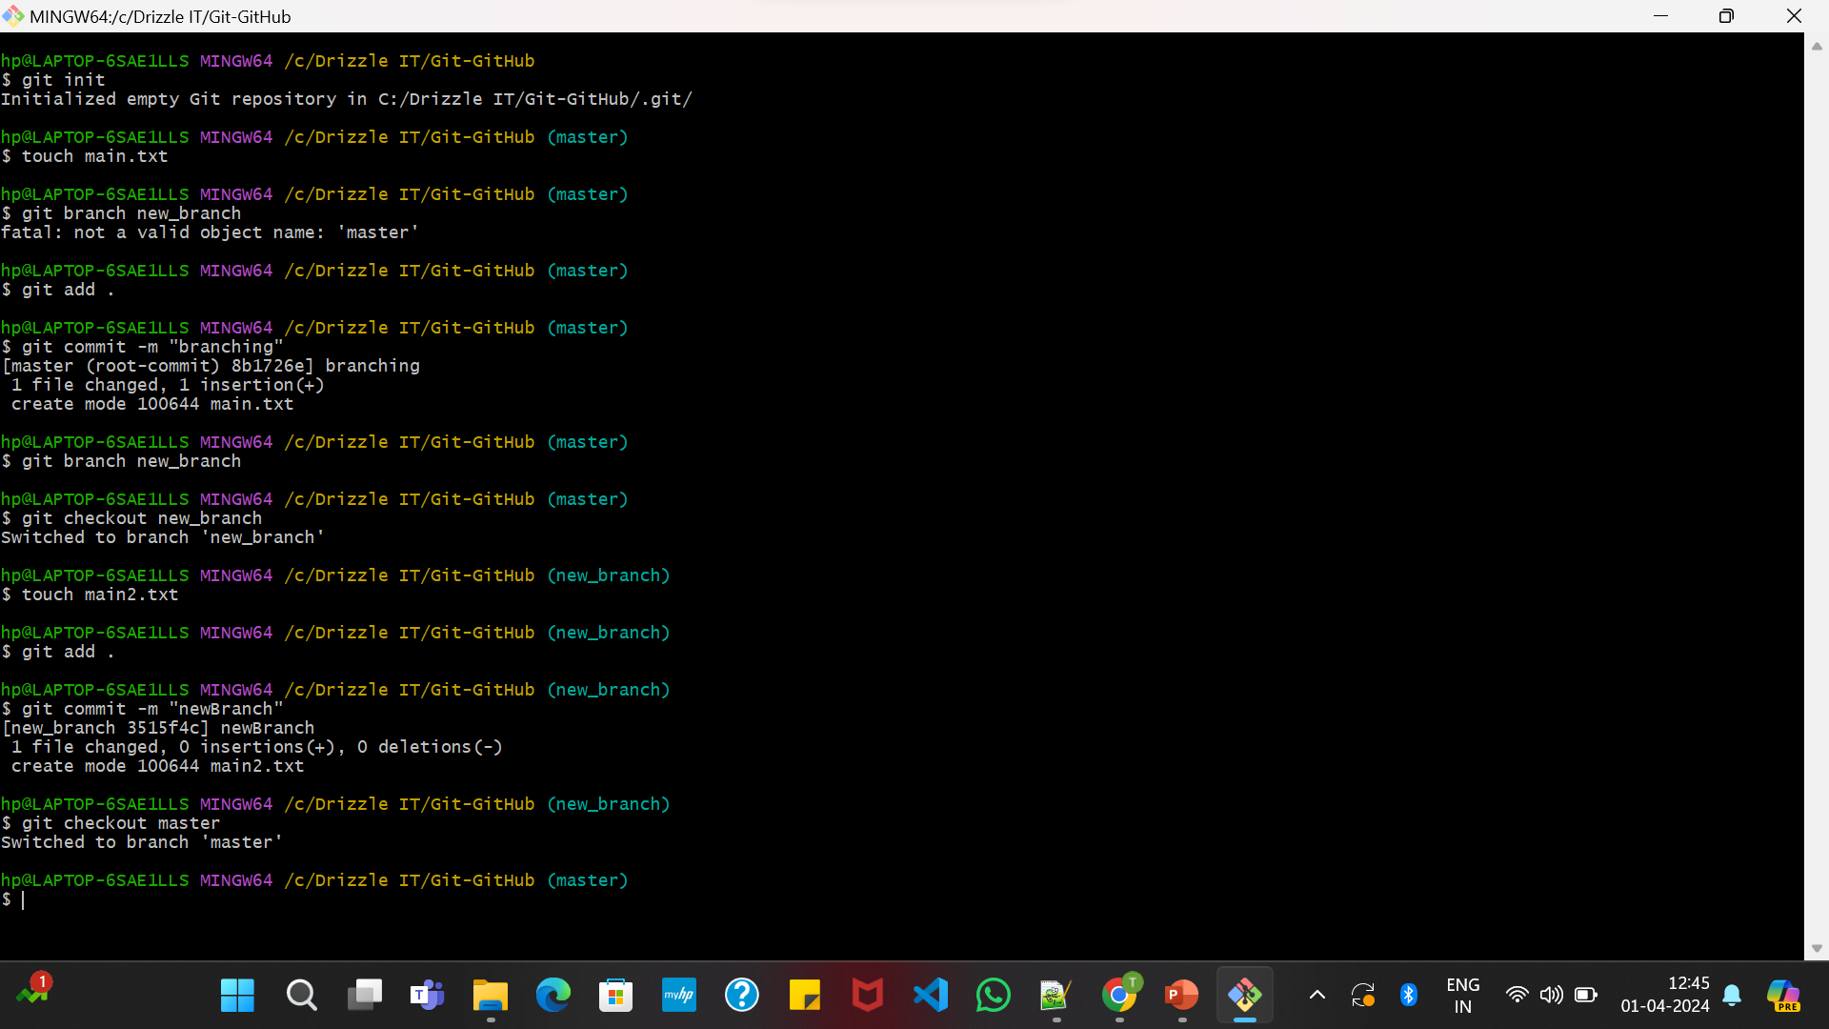

Slide 32
Branch logging and deleting a branch
Delete branch :
git branch –d <branch name>
Error if branch is not fully merged
Force delete branch:
git branch –D <branch name>

Slide 33
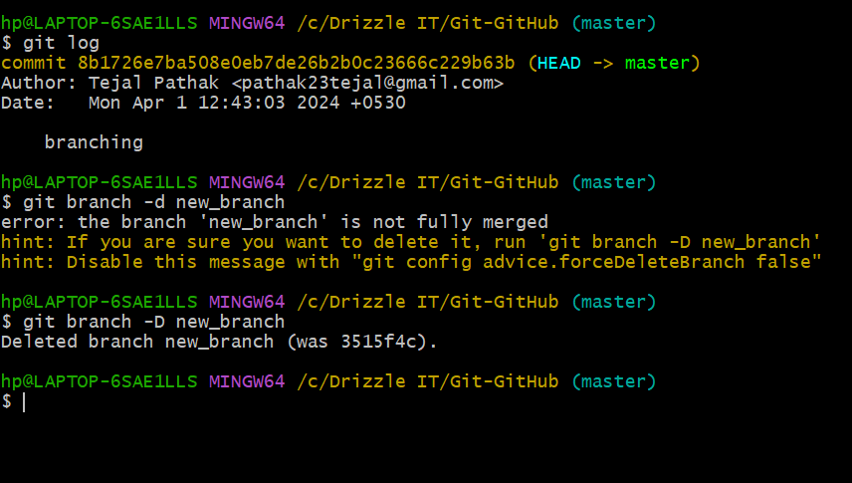

Slide 34
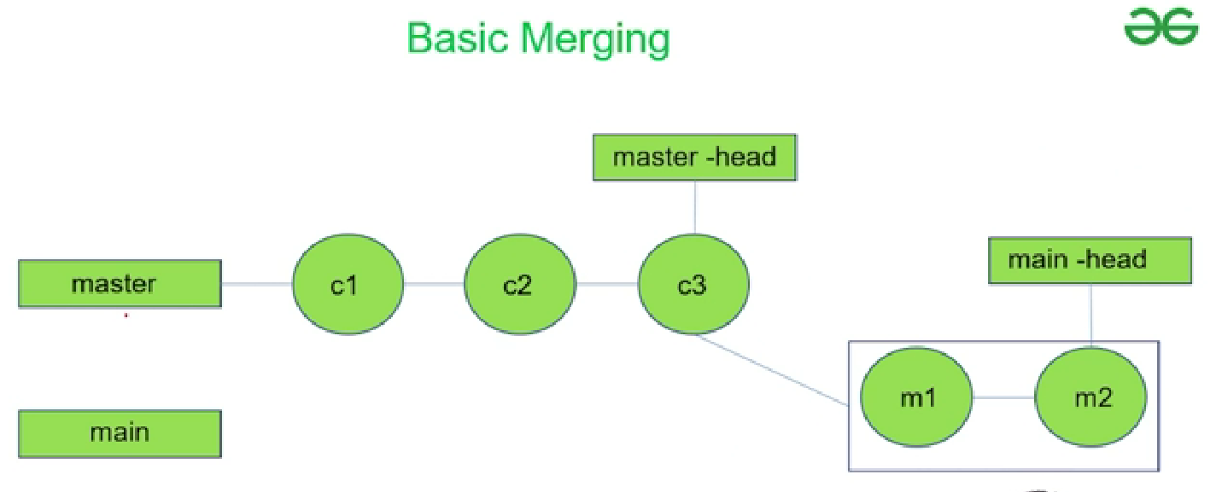
Merging: Basic merging

Slide 35
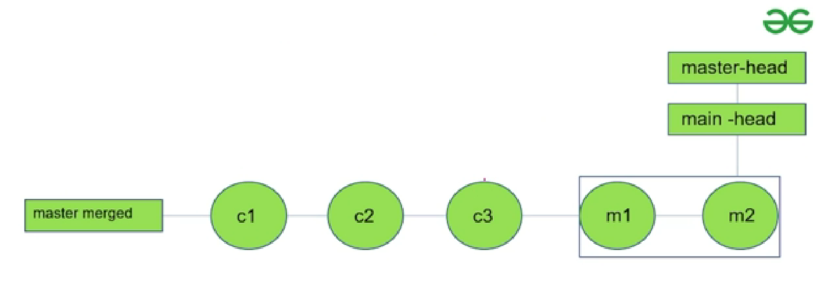

Slide 36
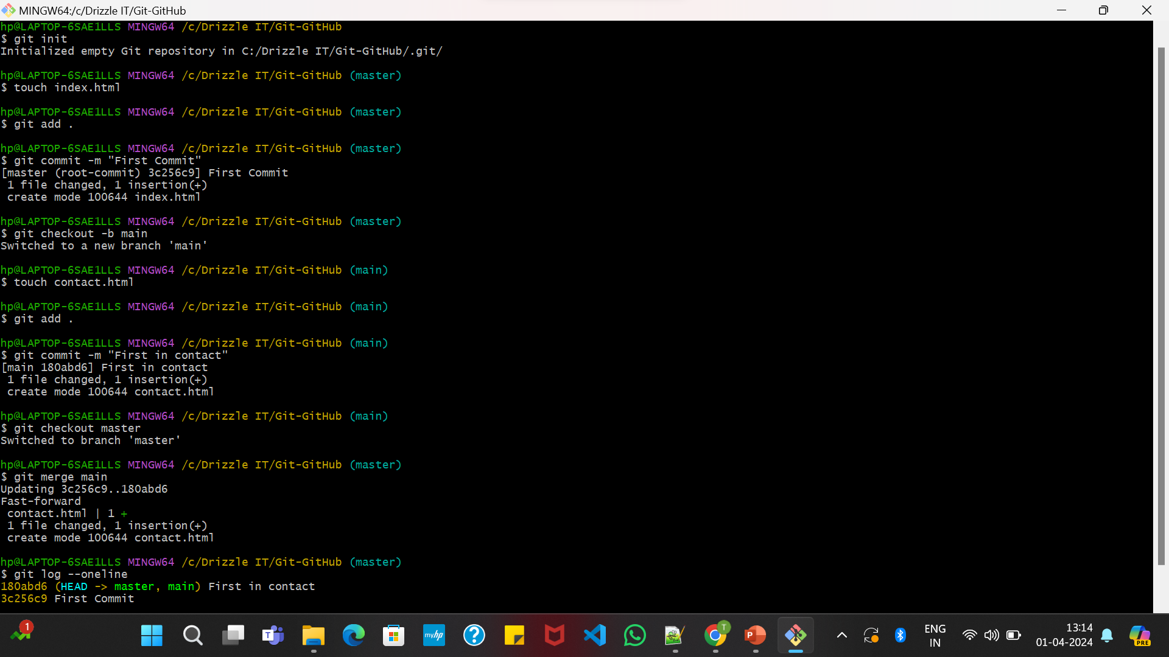

Slide 37
Merge Conflicts
A merge conflict is an event that occurs when git is unable to automatically resolve differences in code between two commits.

Slide 38
Rebasing – What is rebasing and how it is different from merging.
Rebasing is changing the base of your branch from one commit to another making it appear as if you'd created your branch from a different commit.
The output which we get from rebasing and merging is the same, but the process is quite different.
Rebasing cuts all the previous commits and add it to the last commit of the master branch.
But, in merging last commit of the main branch is merged to the last commit of the master branch.
Final product of both is same, but how they are working internally is different.

Slide 39
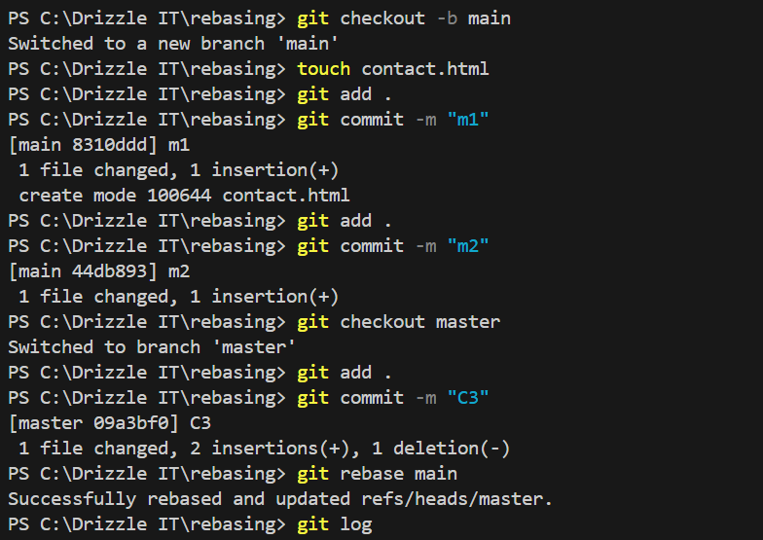
Rebasing a branch
Command : git rebase <branch_name>

Slide 40
Advantages and disadvantages of rebasing
Advantages :
The log history looks more clean as every commit evens the commit in the other branch will be added together. So you can have a look at all the commits of all branches together.
Disadvantages :
Never rebase the commits that exists outside your repository.

Slide 41
Stashing
Stashing takes modifies tracked files, stage changes, and saves them on stack of unfinished changes that you can reapply at any time.
Command : git stash
Before your using git stash you need to put all the files into staging area. (git add .)
So the concept is before actually doing the commit in second file we want to commit new changes in 1st file without even loosing the data, we use stashing.

Slide 42
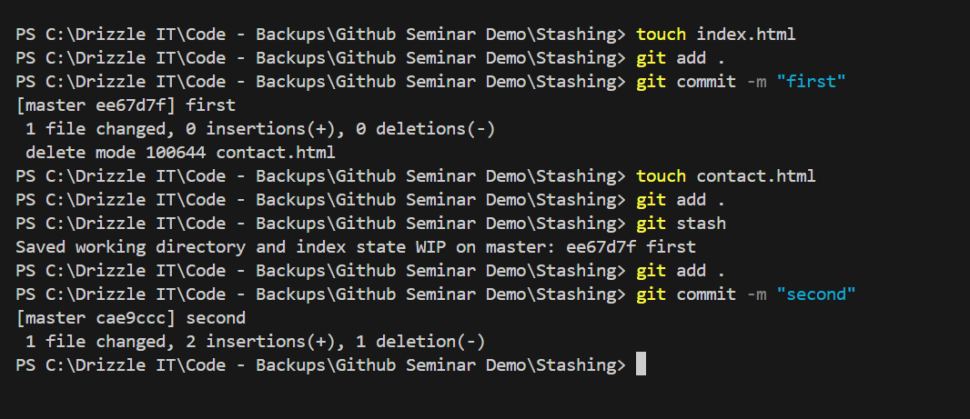

Slide 43
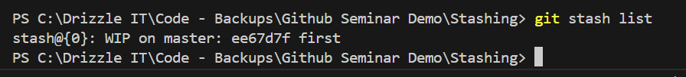
git stash list – gives list of all stashes
git stash apply stash@{}
git stash drop stash{}
E.g.

Slide 44
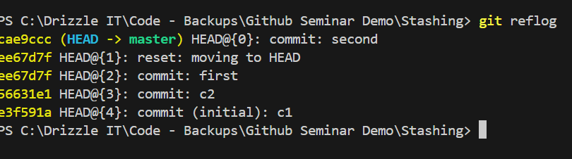
Reflog
Something similar to git log but not exactly git log.
Command : git reflog
The reflog is basically the list of commits that HEAD has previously pointed to or you can say undo history of repository.

Slide 45
GitHub: What is GitHub and how it is different from git
GitHub is cloud based hosting services that lets you manage the git repositories.
Git vs. GitHub
Git | GitHub
Software | Service
Locally installed | Cloud based
Command line interface | Graphical user interface

Slide 46
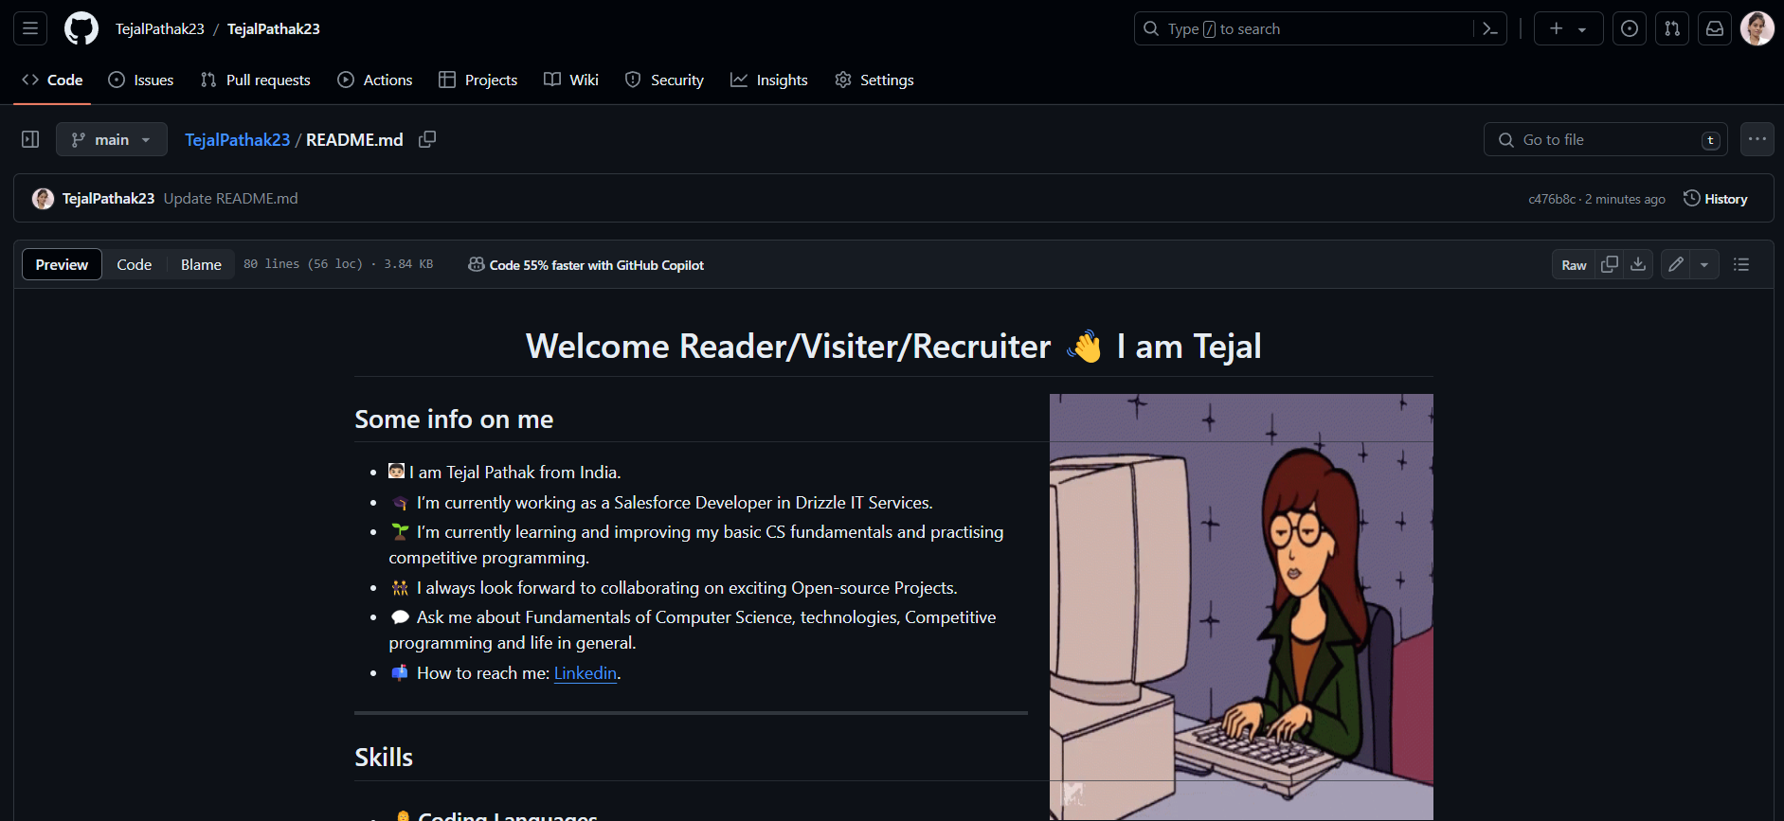
Creating a GitHub repository
Open your GitHub account.

Slide 47
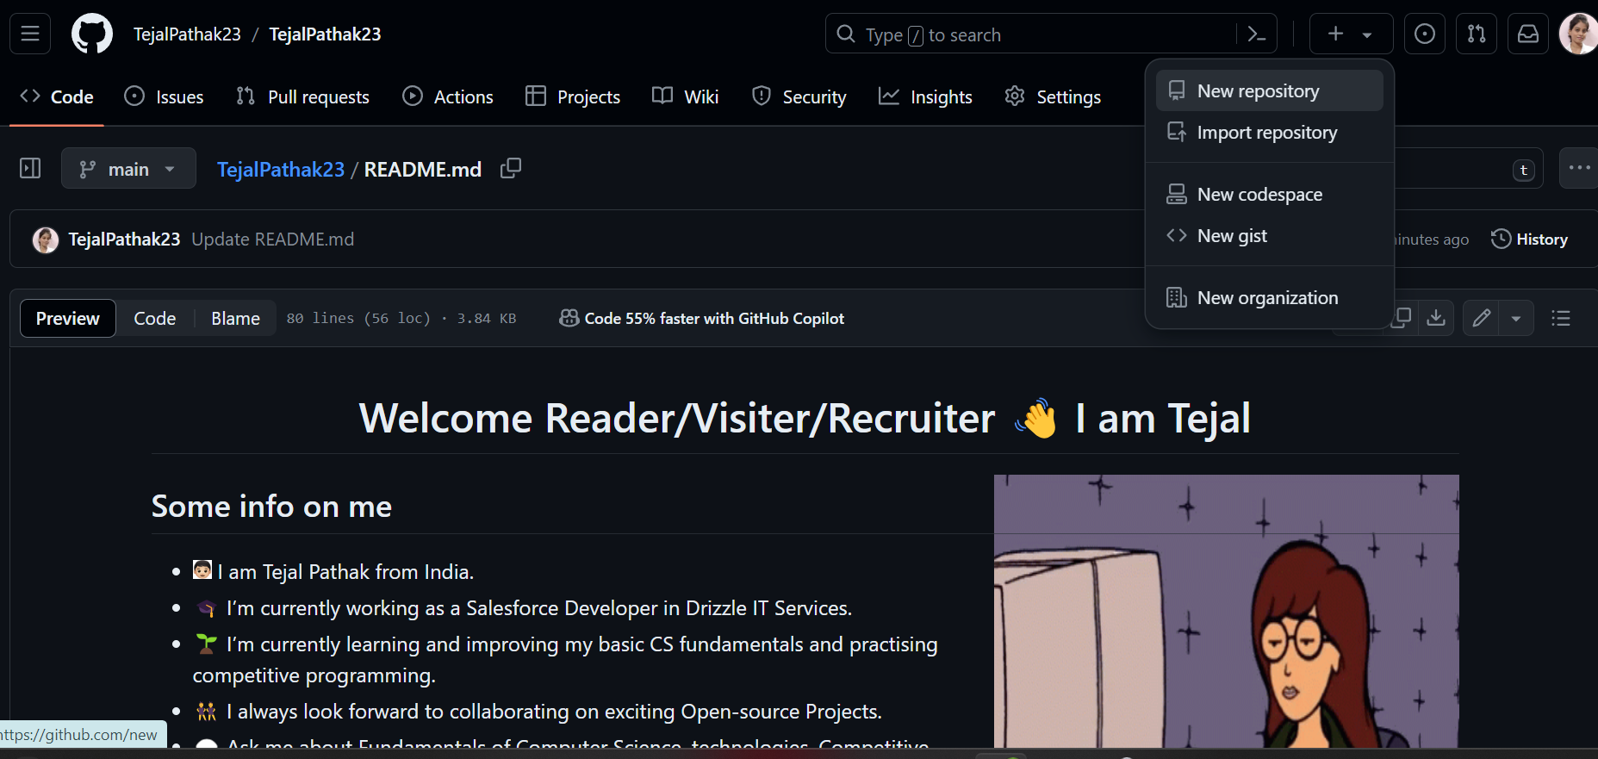

Click on new repository to create new repository.

Slide 48
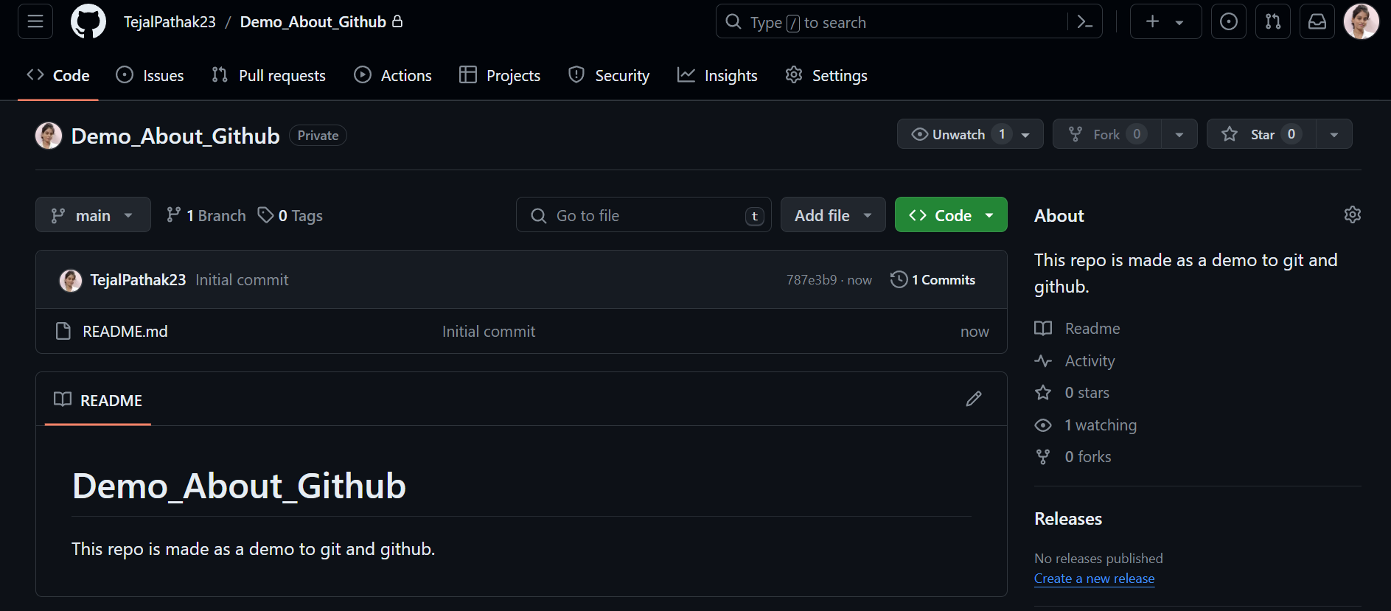

Hence, this type of repository is been created.

Slide 49
Uploading existing project on GitHub git-ignore
Commands
git init
git add .
git commit –m “message”
git remote add origin <remote URL>
git push origin master

Slide 50
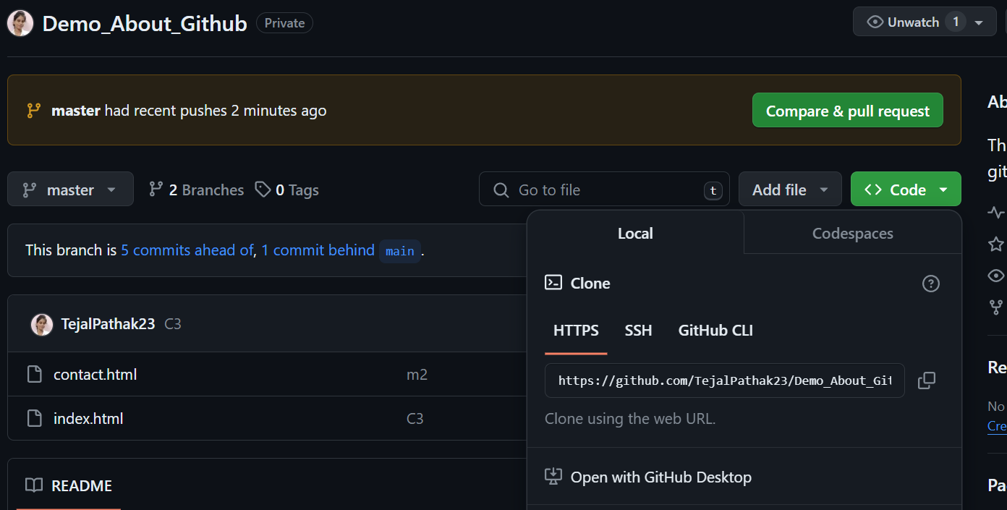

You will get that remote URL from : code -> Local -> HTTPS

Slide 51
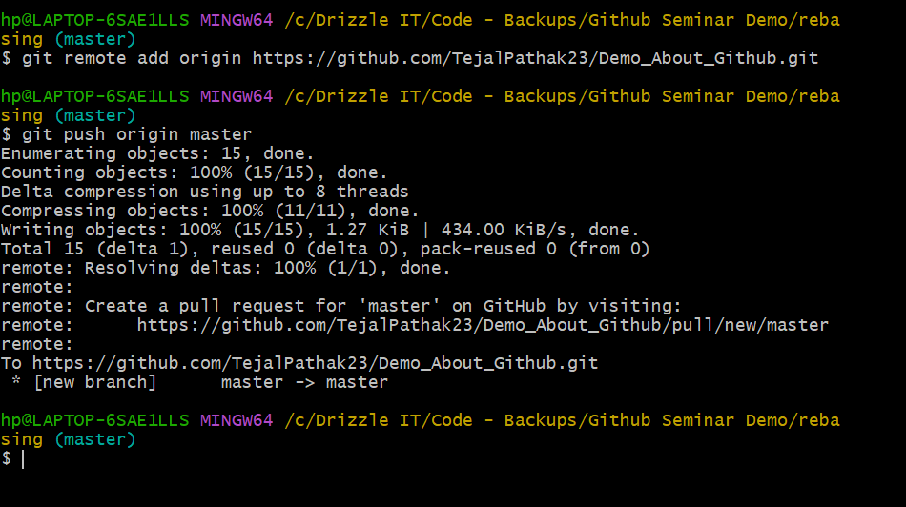

Slide 52
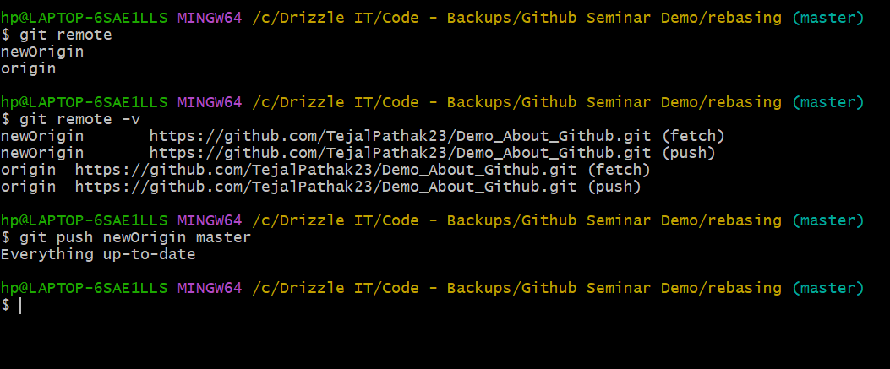
Working with remote repositories

Slide 53
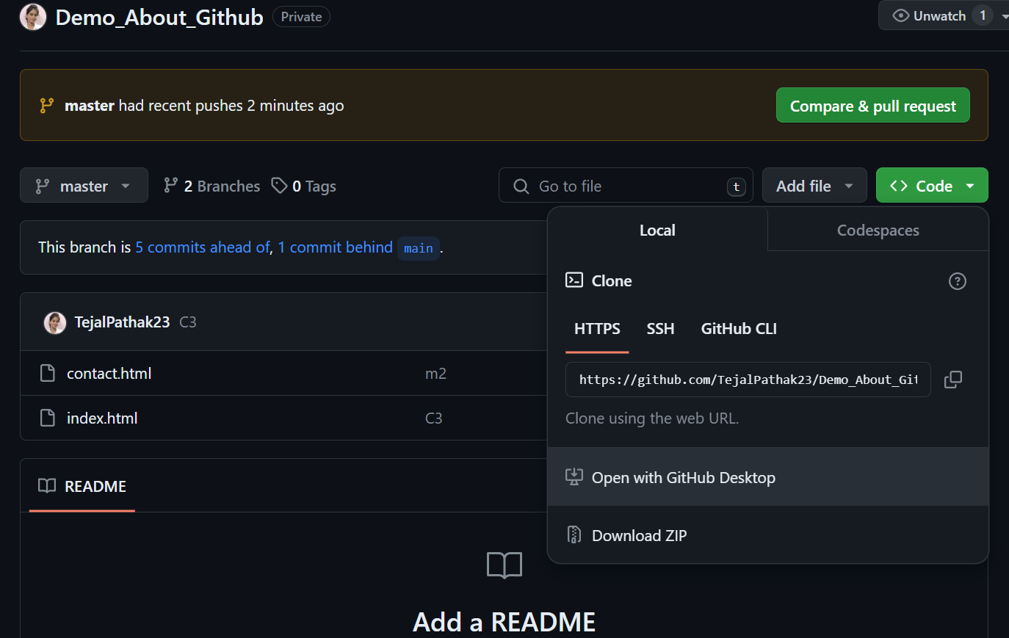

Cloning a repository
Cloning helps us to work on anyone’s code locally on our system.
Option 1 : Download zip file.

Slide 54
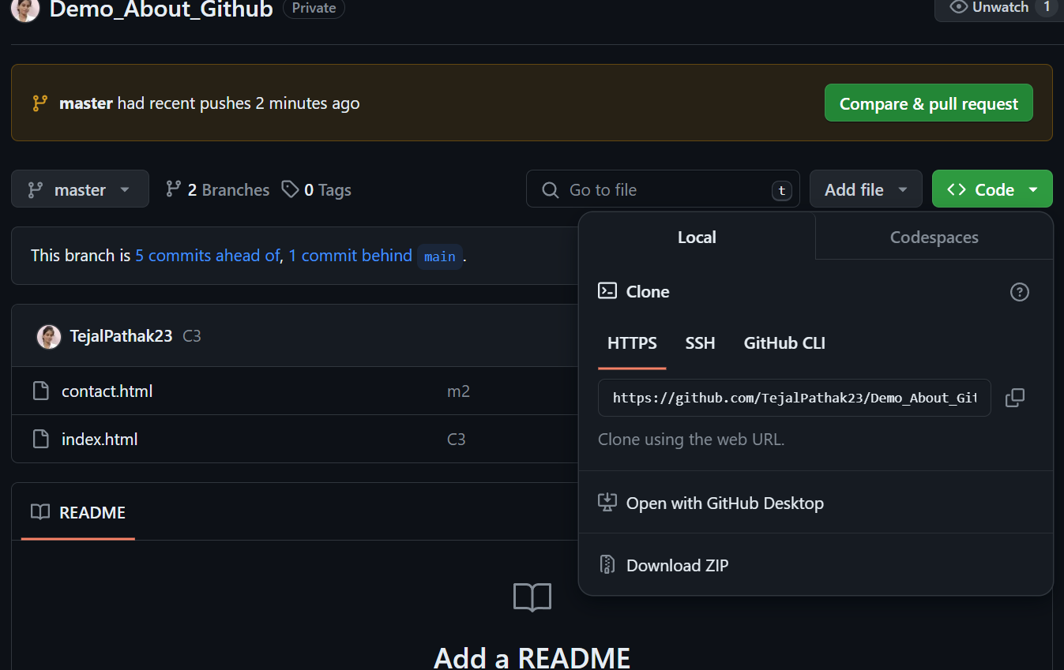

Option 2: Copy this URL

Slide 55
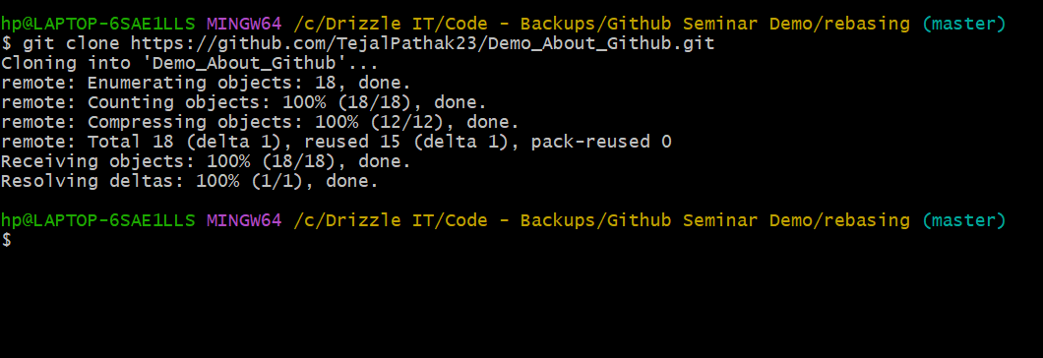
Open gitbash -> type this command: git clone <remote url>

Slide 56
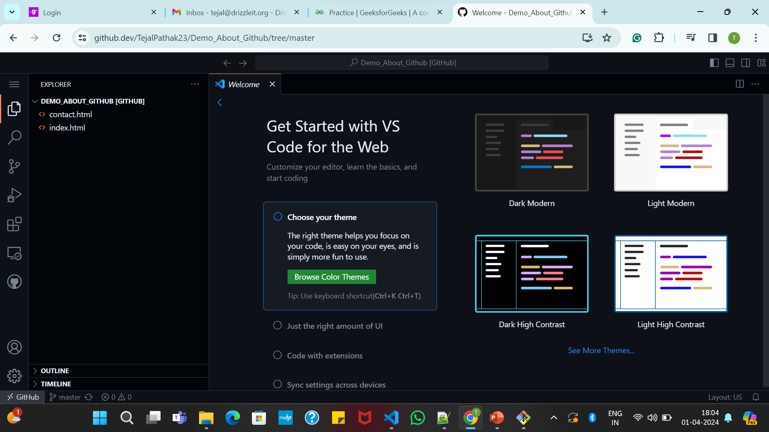
Option 3: go to that repository page -> click . -> automatically it will open a code editor similar to vs code.

Slide 57
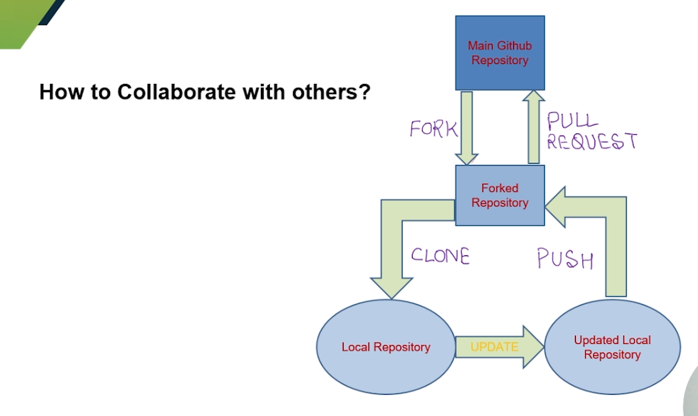
Forking a repository
Forking is making a distinct separate copy of source code.

Slide 58
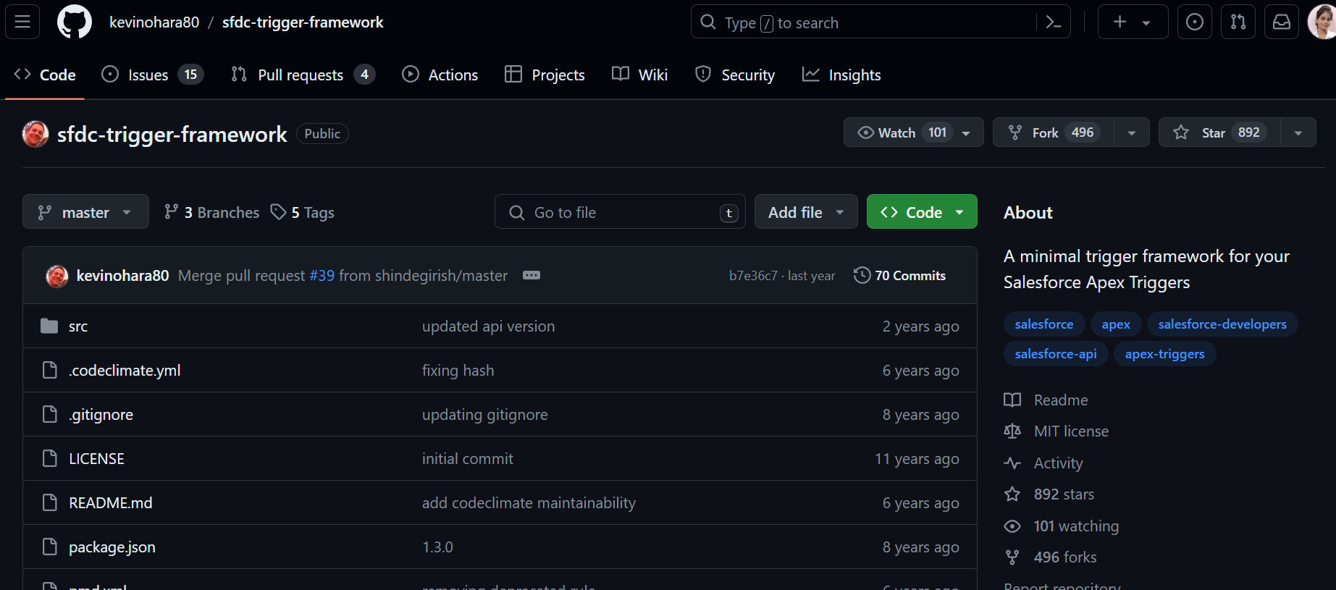


Slide 59
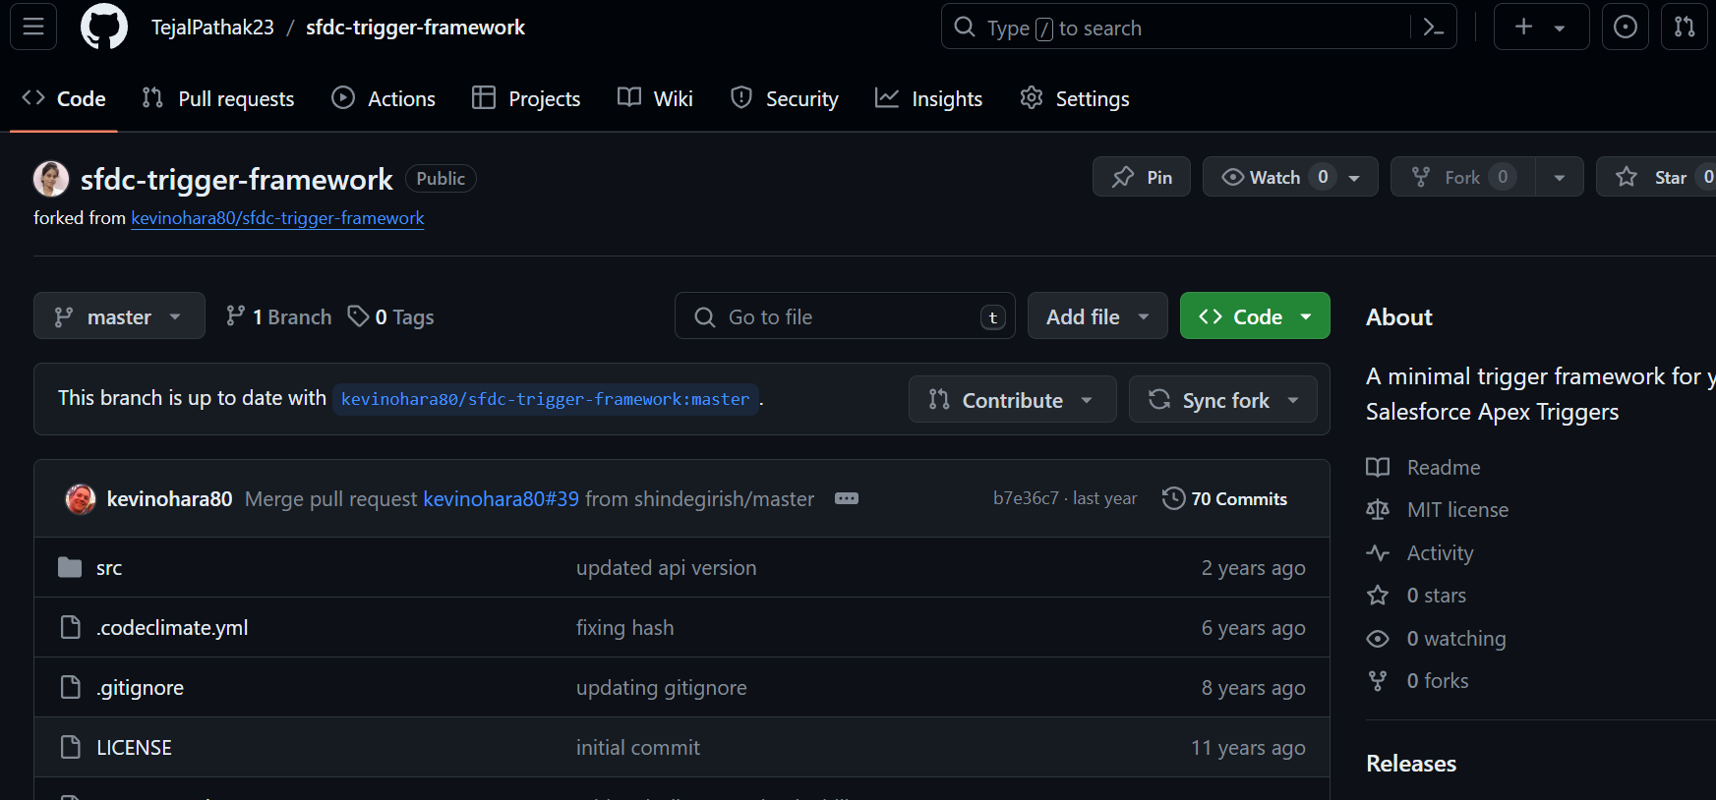


After we forked this repository -> our version of the forked repository get’s created.

Slide 60
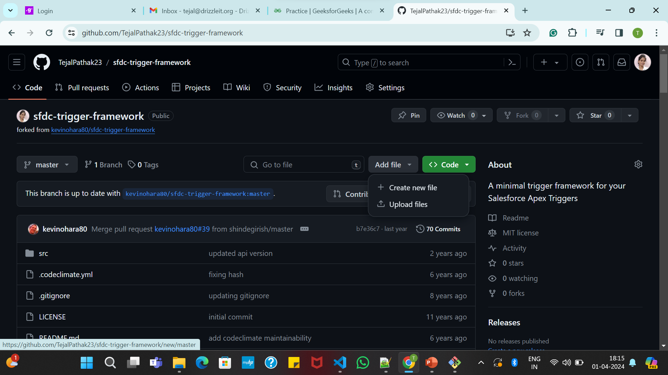

You can edit this repo, you can add & upload files, commit changes

Slide 61
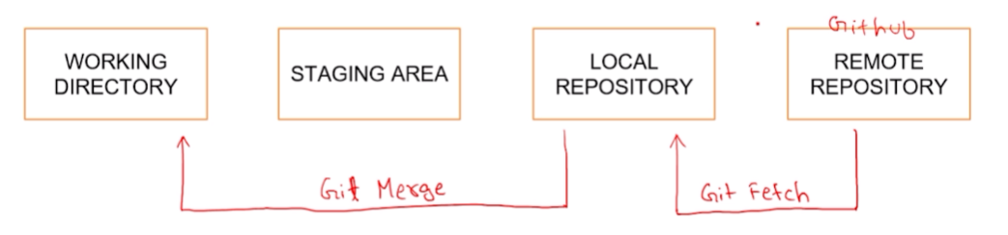
Fetching changes from GitHub
To fetch the latest changes made into the repository.
Command : git fetch
With the help of this command it downloads, commits, files and refs from a remote repo into your local repo.

Slide 62
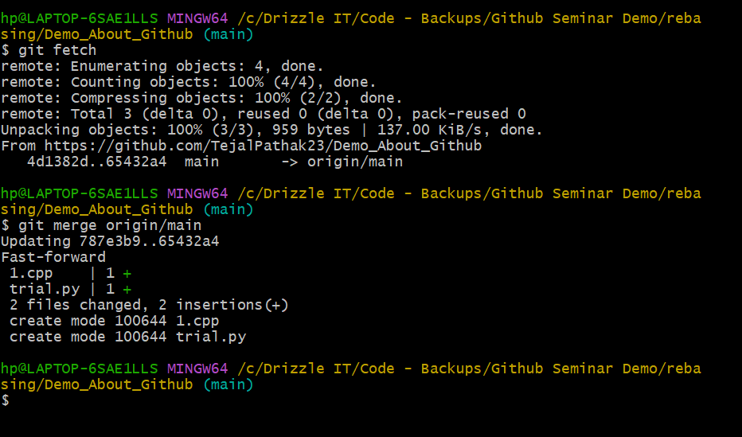
Command : git merge
Instead of main sometimes u may need to use
master, if u haven't include readme file

Slide 63
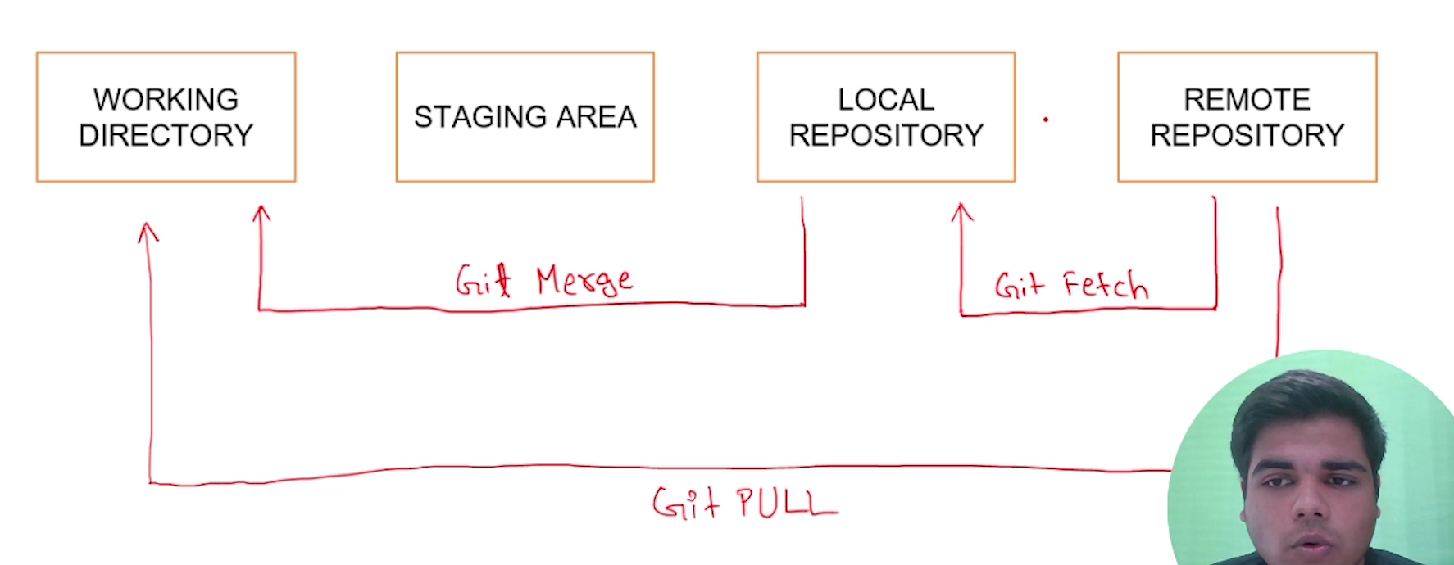
Git fetch vs. git pull
Git pull = git fetch + git merge
☺

Slide 64
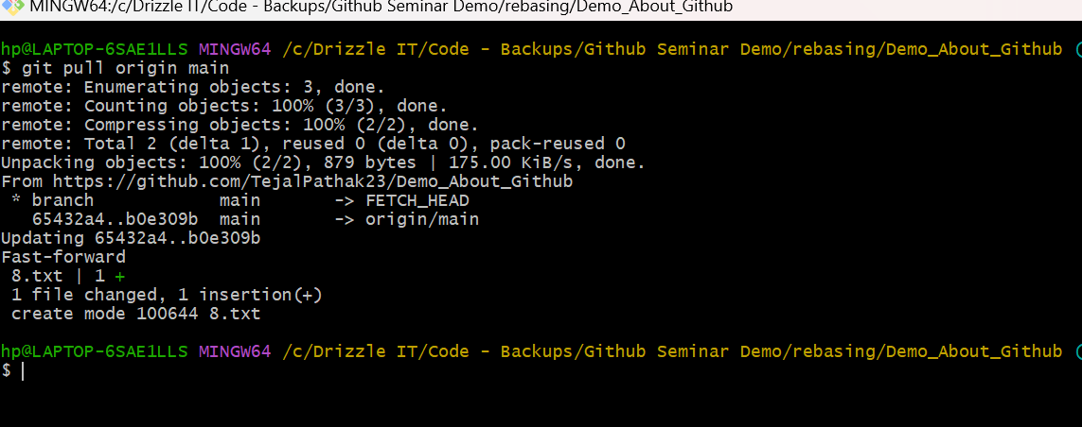

Slide 65
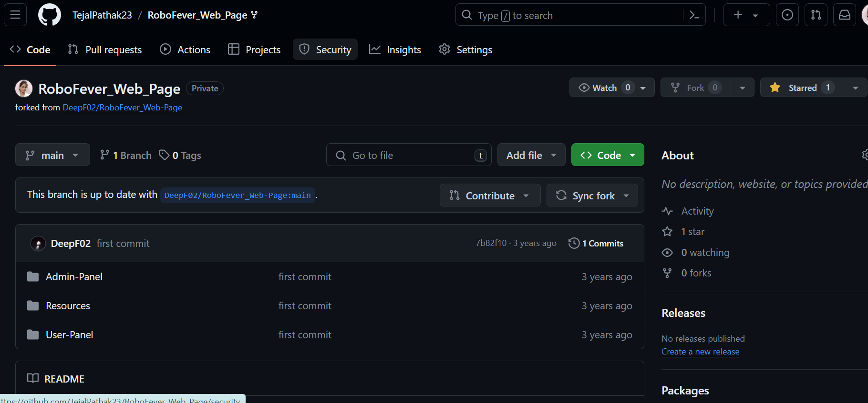
Creating a Pull request
Pull requests let you tell others about changes you've pushed to a branch in a repository on GitHub.
Step 1 : Fork a repository.

Slide 66
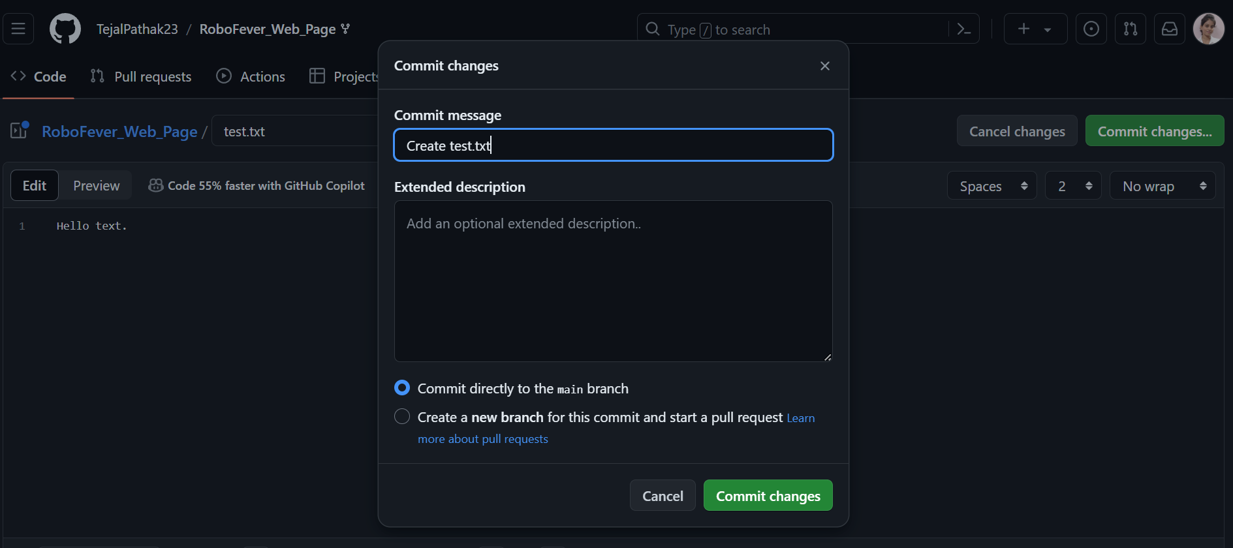
Step 2: Add new file and commit the changes.

Slide 67
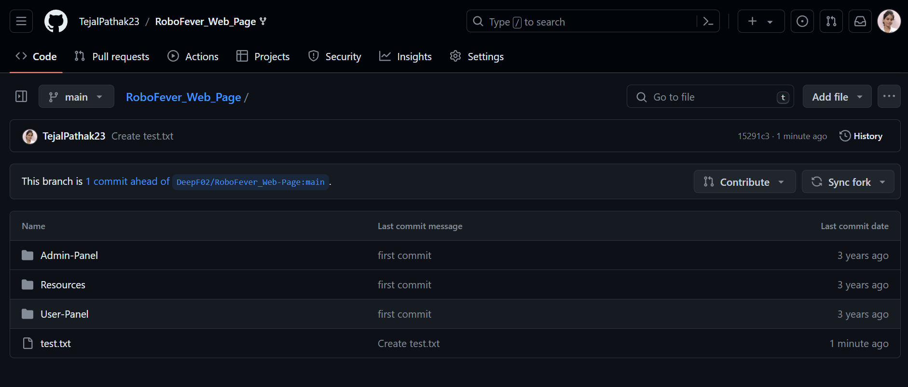


Slide 68
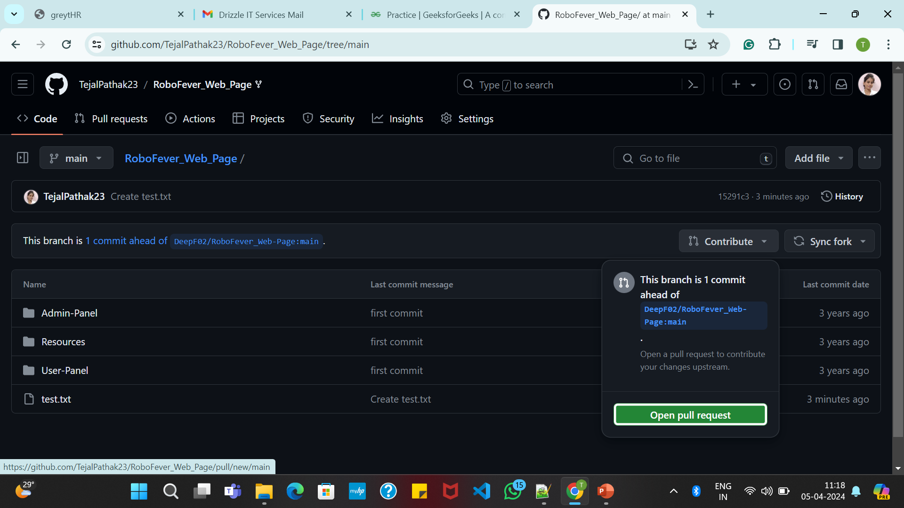
Step 3: Click contribute -> Open pull request.

Slide 69
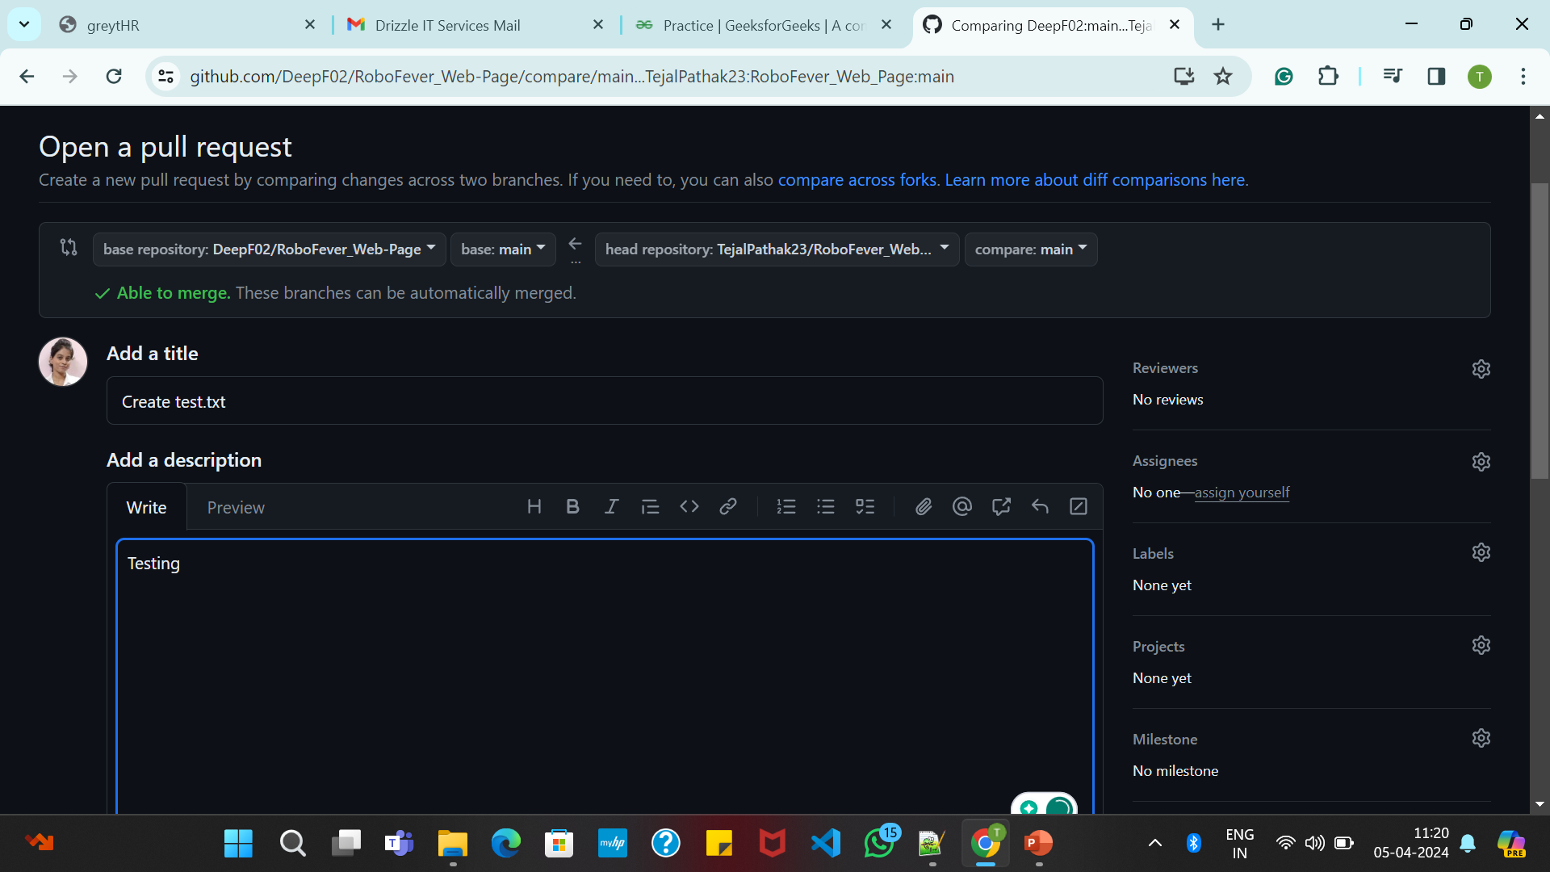

Slide 70
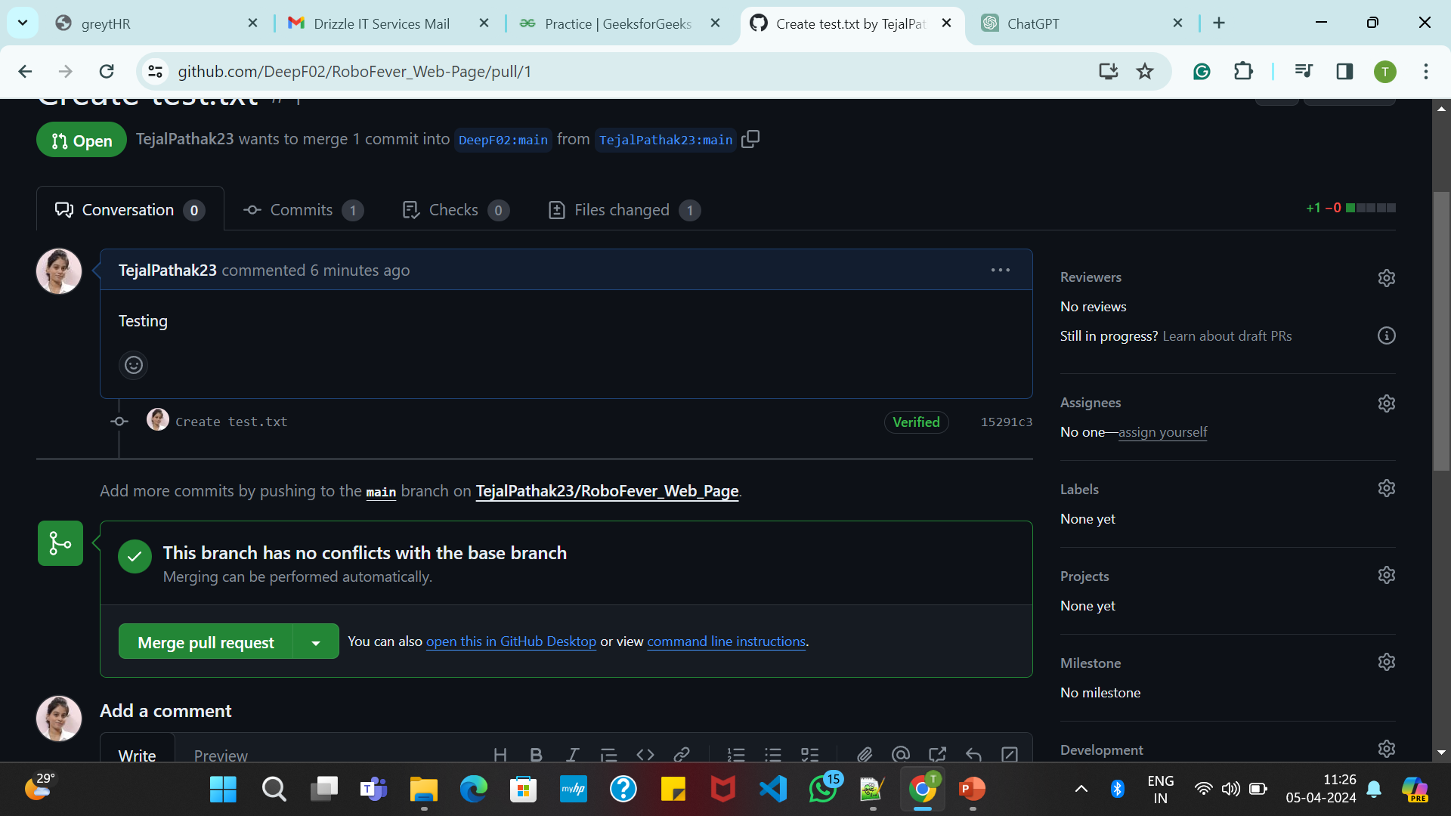

Last Step: After we do the needful, we’ll get this window.

Slide 71
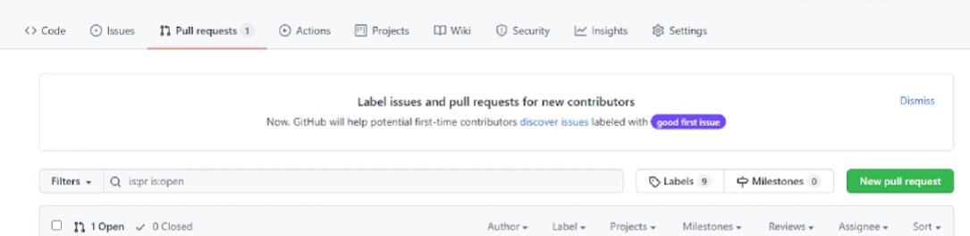
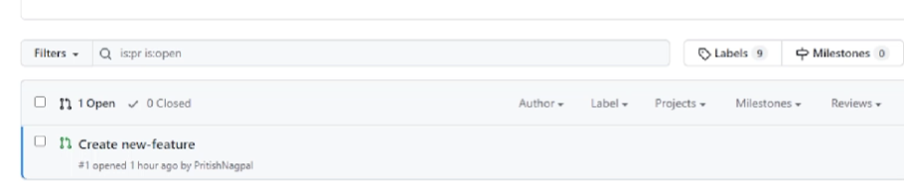


Merging a Pull request
In the original repo we get this option.

Slide 72
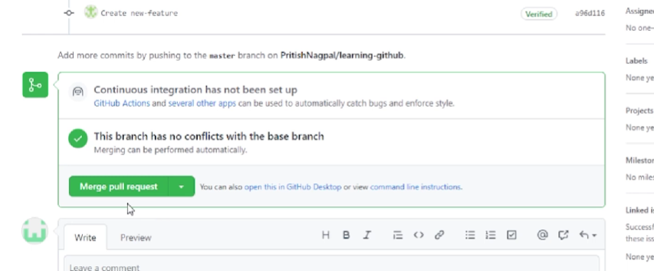



Then click-> Merge Pull request option , also you can give some feedbacks.

Slide 73


The last step would be to confirm the merge, you have the option of closing the merge request, If you do so then the request cannot be merged.

Slide 74
Creating issues on GitHub
GitHub Issues are items you can create in a repository to plan, discuss and track work. Issues are simple to create and flexible to suit a variety of scenarios. You can use issues to track work, give or receive feedback, collaborate on ideas or tasks, and efficiently communicate with others.

Slide 75


When you open any repository, you will see an issues tab in it.

Slide 76


Create new issue by clicking on new issues button.

Slide 77



Write your issue -> Describe it -> Add suitable labels -> Submit

Slide 78


The next time you will visit the repository, you will see open issues.

Slide 79
Deploying static sites on GitHub
Static web pages/Static websites are those sites which do not need a server to run.
Note : The repository must be public in order to use this feature.
GitHub pages :
Deploy static websites.
Share working demo of your code.
Showcase your portfolio.

Slide 80


Note: If you want to deploy your site using GitHub pages, then your main file should be named as index.html ,otherwise that GitHub pages would not even work.

Slide 81



Go to settings -> pages

Slide 82



Select the branch as main -> click Save

Slide 83


Reload the page , you will get the URL where the site is been hosted.

Slide 84

Output : Your hosted site.

Slide 85
Exploring network graphs on GitHub
The network graph displays the branch history of the entire repository network, including fork branches. This graph is a timeline of the most recent commits, and shows up to 100 of the most recently pushed-to branches

Slide 86




When you click any repository you will get “Insights” option. Which shows the count of pull request, etc , but to read this is not handy so we have a network option which shows graph.

Slide 87

It will show data into graphical format.

Slide 88
Extra Tools: Cleaning the working repository
We could forcefully delete files from the working directory if they are not yet into staging area.
Command : git clean –f –d
Here, f = force & d = any present directory

Slide 89


Slide 90
Changing commit messages and changes
Suppose in case you commit a file previously with a wrong message, now you want to update that message in this case the command is helpful.
Note: This can be done only for previous commits
Command : git commit – amend
When you write this command then a “vim editor” will open on your screen, where
I = Insert
To exit = esc -> :wq

Slide 91


Slide 92


Slide 93


Now by using git log, you can see the commit message is been changed.

Slide 94

Checking past commits

Slide 95


Slide 96
Checking Past commits:
git checkout <commit_id>
We could get this commit Id by using this command: git log --oneline

Slide 97

Head will be pointing to the most recent commit.

Slide 98

To change the previous commit the head must be pointed to that specific commit.

Slide 99


Slide 100


Slide 101

Git Reset
Deletes the commit from the top and resets head to the given id.

Slide 102
git reset <commit_id> : By default it is soft, Deletes the commit but you can still get back the changes introduced in those deleted commits.
git reset <commit_id> -- hard : Deletes the commit and even the changes introduced in that commit.

Slide 103


Slide 104
Reverting Commit
The changes introduced by the commit can be reversed using revert command.
git revert <commit_id> : reverts the commit and again commits the result.
git revert –n <commit_id> : reverts the commit but do not again commit the result. You have to explicitly commit the files.
git revert –abort : Aborts the current revert operation

Slide 105

Deleting commits from github
Command: git reset <commit_id>

Slide 106


